Slide 1
Object detection Using YOLOv8 and Streamlit DATA 606 Capstone
By:
Srikar Nikhil Vanama
Professor :Chaojie Wang

Slide 2
Introduction to YOLOv8 and Object Detection
(You Only Look Once), YOLO - a state-of-the-art object detection model.
Object detection is a fundamental task in computer vision with numerous real-world applications.
YOLOv8 is a highly efficient and accurate object detection model that can process images rapidly.
It enables the identification and localization of objects in images and videos, powering a wide range of technologies

Slide 3
Data Collection:
The COCO dataset is a widely used benchmark for object detection research.
Dowload the dataset directly from the website (https://cocodataset.org/).
It contains over 200,000 labeled images with 80 object categories.
This is the format of coco dataset:
train2017.zip - Contains the training images
val2017.zip - Contains the validation images
annotations_trainval2017.zip - Contains the annotations for both the training and validation sets

Slide 4
About COCO Dataset
Image Annotations: Each image has labels and bounding boxes around objects.
Object Categories: It covers a wide range of everyday objects.
Complexity and Diversity: The dataset includes various settings and backgrounds
Instance Segmentation Annotations: In addition to bounding boxes, some images have pixel-level segmentation masks for objects

Slide 5
Data Subsetting
Limited computational resources and the need for faster experimentation during the model development process.
Training on the full COCO dataset may be computationally intensive, especially on resource-constrained environments.
Used about 10% of the actual data and stored that into the google drive which was accessed through Google colab.
Number of training images: 5922
Number of validation images: 1000
Number of objects in training set: 43458
Number of objects in validation set: 7155
Number of object categories: 80

Slide 6
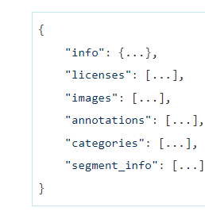
COCO Annotations:
Structure of the COCO annotations: 'images': Information about the images, including file names and dimensions.
'annotations': Bounding box and category information for the annotated objects.
'categories': Definitions of the 80 object categories in the COCO dataset.
Image source:www.immersivelimit.com/

Slide 7
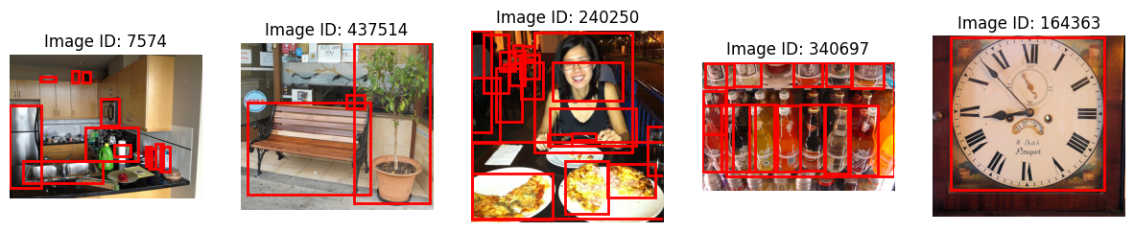
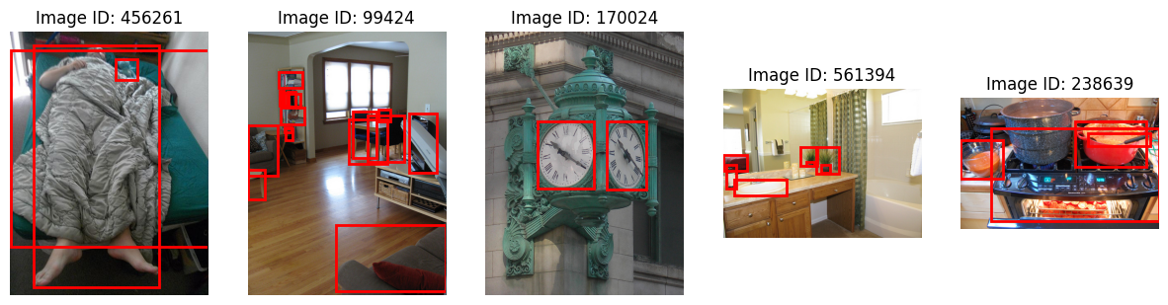
Sample Images from the DataSet (Bounding boxes drawn using PIL using the coordinates from the annotation data):

Slide 8
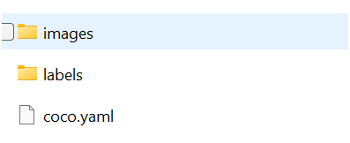
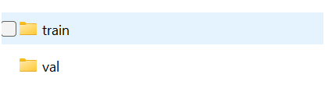
Converting COCO format to YOLO Format
This is crucial step. converting a dataset from coco format to YOLO is required, as YOLO Expects the training data to be in certain format.

Slide 9
Training with YOLOv8
Epochs | Precision | Recall | mAP@0.50 | mAP@0.50:0.95 | Fitness
50 | 0.571 | 0.458 | 0.503 | 0.358 | 0.372
100 | 0.617 | 0.492 | 0.562 | 0.416 | 0.431
171 | 0.469 | 0.308 | 0.34 | 0.222 | 0.234
Training Metrics:
Using the full COCO dataset may lead to better model performance but require more computational resources.
Epochs | Precision | Recall | mAP@0.50 | mAP@0.50:0.95 | Fitness
50 | 0.674 | 0.404 | 0.494 | 0.353 | 0.367
100 | 0.609 | 0.512 | 0.577 | 0.431 | 0.445
171 | 0.402 | 0.32 | 0.343 | 0.222 | 0.234
Validation Metrics:

Slide 10
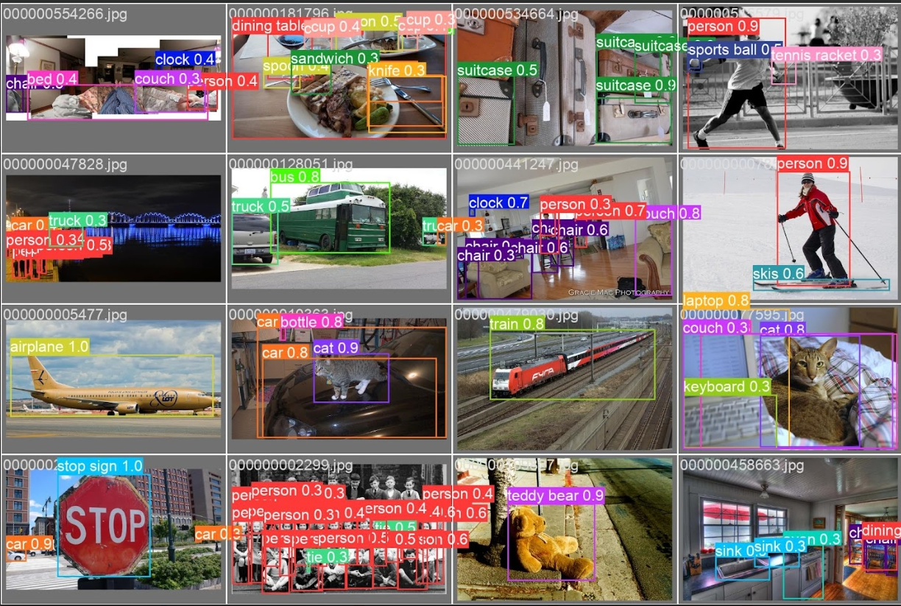
Some Predictions with YOLOv8

Slide 11
Next Steps
Currently the model is able to detect Both Images and Videos and can be extended to include Live camera and YouTube Links.
Deploy the web app to a cloud platform or using the Streamlit Deploy
Train With a Larger Dataset to improve performance.

Slide 12
Web App Demo

Slide 13
References:
YOLOv8 Paper: Chien-Yao Wang, Alexey Bochkovskiy, Hong-Yuan Mark Liao,
YOLOv7: Evolving YOLO for Object Detection, arXiv:2207.02696, https://arxiv.org/abs/2207.02696
Ultralytics YOLOv8: Ultralytics YOLOv8 GitHub repository
Ultralytics Docs: Ultralytics YOLOv8 official documentation, https://docs.ultralytics.com

Slide 14
Thank you

